Slide 1

RAJESHWARI VEDHACHALAM GOVERNMENT ARTS COLLEGE - CHENGALPATTU
OPTIMIZING SPAM
FILTERING
-Guide name-
DR.T.Vani
Team Members:
K. Indhumathi
T. Sumithira
D. Sasikala
B. Kalaivani

Slide 2

INTRODUCTION
The objective of developing this model is to detect and
score word faster and accurately.
The reason for spam filters is to distinguish inbound Malignant messages
from programmers or advertisers.
NEEDED:
Internet Service Providers (ISPs) use spam filters to make sure they
aren't distributing spam.
Why called sapm?
The name comes from a Monty Python sketch, (watch it, below!) where the name
of the canned pork product, SPAM, is annoying and unavoidable.
Just like SPAM email.

Slide 3
Spam Vs Ham
Blacklists and Whitelists
BLACKLISTS - of misbehaving servers or unknown spammers that are collected by several sites
Sender id in the email is compared with the blacklists
WHITELISTS- are complementary to black lists, and contain addresses of trusted contact
Use blacklists and whitelists for the first level filtering and not used as the only tools for making decision
“HAM”- is e-mail that is not spam. In other word
”NON- SPAM” or “GOOD MAIL”
“SPAM”– is also known to mean
”Sales Promotional Advertising Mail” or “Silmultaneously Posted Advertising Message”
Two type of spam
computer spam
Text spam

Slide 4
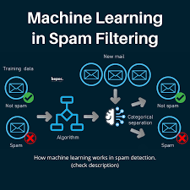
Supervised Machine Learning
Spam detection is a supervised machine learning problem.
This means you must provide your
machine learning model with a set of examples of SPAM and HAM messages and let it find
The relevant patterns that separate the two different categories.

Slide 5
REQUIREMENT ANALYSIS
Functional requirement
To classify the e-mails which is done by first taking out the feature vector extraction
which invokes first taking out whether the world is a spam or not.
Non-Functional Requirement
Ensure high availability of email data here datasets.
It should be easy to use i.e., user is just required to type the words and click then
the result is displayed or user is just required to enter a pair of reasonable sentence.

Slide 6

PROBLEM STATEMENT
Unwantedd e-mails irritation internet connection
Critical e-mail message are missed and /or delayed
Millions of compromised computers
Billions of dollars lost worldwide
Identity theft
Spam can crash mail serves and fill up hard drivens

Slide 7
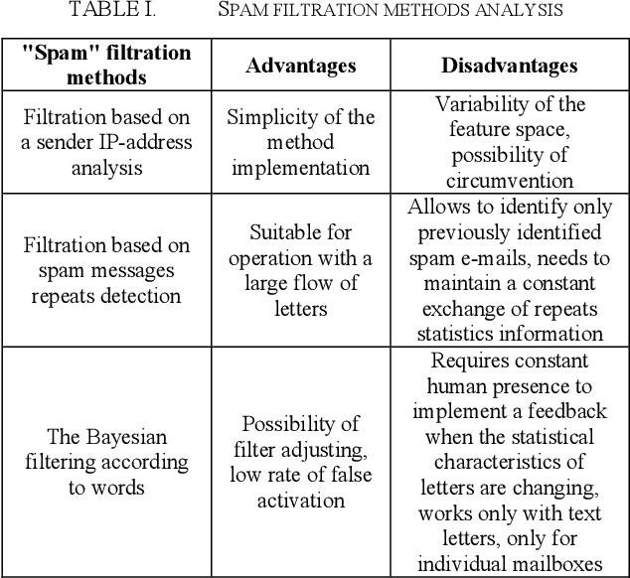

Slide 8

SCOPE OF THE PROJECT
It provide sensitivity to the client
Adapts well to the future spam techniques
It increase security and control
It also reduce Network Resource Costs
It considers a complete message instead of single words with respect
To its organization

Slide 9
conclusion
We are able to classify the email as spam or
non-spam.With high number of emails lot if
people using the system it will be Difficult to
handle all possible mails as our project deals
with only Limited amount of corpus.

Slide 10
THANK YOU

